Slide 1

CSE319 Machine Learning Module 1

Slide 2
CONTENTS
Introduction to Machine learning
Types of Machine Learning
Models selection and generalization
Machine Learning concept work flow
Applications

Slide 3
Introduction to Machine learning

Slide 4
What is Learning?
Herbert Simon: “Learning is any process by which a system improves performance from experience.”
What is the task?
Classification
Categorization/clustering
Problem solving / planning / control
Prediction

Slide 5
Why “Learn” ?
Machine learning is programming computers to optimize a performance criterion using example data or past experience.
Learning is used when:
Human expertise does not exist (navigating on Mars),
Humans are unable to explain their expertise (speech recognition)
Solution changes in time (routing on a computer network)
Solution needs to be adapted to particular cases (user biometrics)

Slide 6
What We Talk About When We Talk About“Learning”
Learning general models from a data of particular examples
Data is cheap and abundant (data warehouses, data marts); knowledge is expensive and scarce.
Example in retail: Customer transactions to consumer behavior:
People who bought “Blink” also bought “Outliers” (www.amazon.com)
Build a model that is a good and useful approximation to the data.

Slide 7
Data Mining
Retail: Market basket analysis, Customer relationship management (CRM)
Finance: Credit scoring, fraud detection
Manufacturing: Control, robotics, troubleshooting
Medicine: Medical diagnosis
Telecommunications: Spam filters, intrusion detection
Bioinformatics: Motifs, alignment
Web mining: Search engines
...

Slide 8
What is Machine Learning?
Optimize a performance criterion using example data or past experience.
Role of Statistics: Inference from a sample
Role of Computer science: Efficient algorithms to
Solve the optimization problem
Representing and evaluating the model for inference
It provides us statistical tools to explore and analyses the data

Slide 9
Applications
Association
Supervised Learning
Classification
Regression
Unsupervised Learning
Reinforcement Learning

Slide 10
Why Study Machine Learning? Developing Better Computing Systems
Develop systems that are too difficult/expensive to construct manually because they require specific detailed skills or knowledge tuned to a specific task (knowledge engineering bottleneck).
Develop systems that can automatically adapt and customize themselves to individual users.
Personalized news or mail filter
Personalized tutoring
Discover new knowledge from large databases (data mining).
Market basket analysis (e.g. diapers and beer)
Medical text mining (e.g. migraines to calcium channel blockers to magnesium)

Slide 11
Related Disciplines
Artificial Intelligence
Data Mining
Probability and Statistics
Information theory
Numerical optimization
Computational complexity theory
Control theory (adaptive)
Psychology (developmental, cognitive)
Neurobiology and many more

Slide 12
Traditional Programming
Data Program
Computer
Output
Machine Learning
Data Output
Computer
Program

Slide 13
Human Learning
It is a process of gaining information through observation, to solve with real world scenarios.
Human learning happens in one of the three ways:
An expert in the subject directly teaches us
We build our own notion indirectly based on what we have learnt in the past
We learn ourselves, may be after multiple attempts.

Slide 14
Types of Human Learning
Learning under expert guidance
Learning guided by knowledge gained from experts
Learning by self

Slide 15
MACHINE LEARNING
A computer program is said to learn from experience ‘E’ with respect to some class of tasks ‘T’ and performance measure ‘P’, if its performance at tasks in ‘T’, as measured by ‘P’, improves with experience ‘E’.
- Tom M. Mitchell

Slide 16
History of Machine Learning
1950s
Samuel’s checker player
1960s:
Neural networks: Perceptron
Pattern recognition
Learning in the limit theory
Minsky and Papert prove limitations of Perceptron
1970s:
Symbolic concept induction
Winston’s arch learner
Expert systems and the knowledge acquisition bottleneck
Quinlan’s ID3
Michalski’s AQ and soybean diagnosis

Slide 17
History of Machine Learning (cont.)
1980s:
Advanced decision tree and rule learning
Explanation-based Learning (EBL)
Learning and planning and problem solving
Utility problem, Analogy
Cognitive architectures
Resurgence of neural networks (connectionism, backpropagation)
1990s
Data mining
Adaptive software agents and web applications
Text learning
Reinforcement learning (RL)
Inductive Logic Programming (ILP)
Ensembles: Bagging, Boosting, and Stacking
Bayes Net learning

Slide 18
TYPES of MACHINE LEARNING

Slide 19
Types of Machine Learning
Supervised learning: A machine predicts the class of unknown objects based on prior class-related information of similar objects. Also called predictive learning.
Unsupervised/clustering learning: A machine finds patterns in unknown objects by grouping similar objects together. Also called descriptive learning.
Reinforcement learning: A machine learns to act on its own to achieve the given goals.

Slide 20
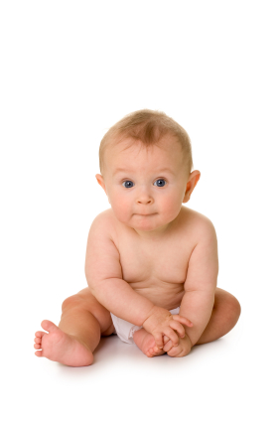

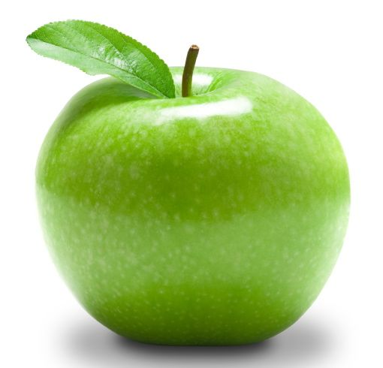
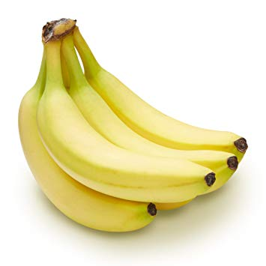
SUPERVISED LEARNING
The major motivation of supervised learning is to learn from past information.
But how do machine learns?
By TRAINING DATA using labels.
What’s this?
Apple
Banana
It’s an Apple

Slide 21
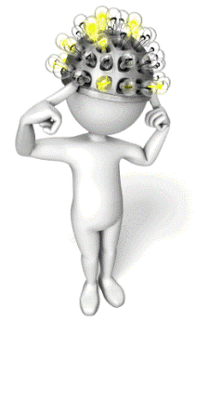
Training Data
Triangle Circle Rectangle
Testing Data
Triangle Circle Rectangle

Slide 22
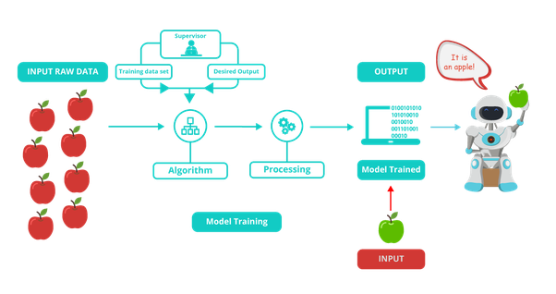
Supervised Learning

Slide 23
Examples of Supervised Learning
Predicting the results of a game.
Predicting a tumour is malignant or benign.
Predicting the piece of domains like real estate, stocks, etc.
Classify texts such as classifying a set of emails as spam or non-spam.

Slide 24
Classification & Regression
When we are trying to predict a categorical or nominal variable, the problem is known as a classification problem.
Ex: Identify Cat or Dog
When we are trying to predict a real-valued variable, the problem falls under the category of regression.
Ex: Predict the value of a property.

Slide 25
Unsupervised Learning
Unsupervised learning(USL) is a type of self-organized learning that helps find previously unknown patterns in data set without pre-existing labels.
The objective is to take a dataset as input and try to find natural grouping or patterns within the data elements or records.
Hence, USL is termed as Descriptive Model and the process of USL is called Pattern or Knowledge Discovery.
In unsupervised learning, the system is presented with unlabeled, uncategorized data and the system’s algorithms act on the data without prior training. The output is dependent upon the coded algorithms.

Slide 26
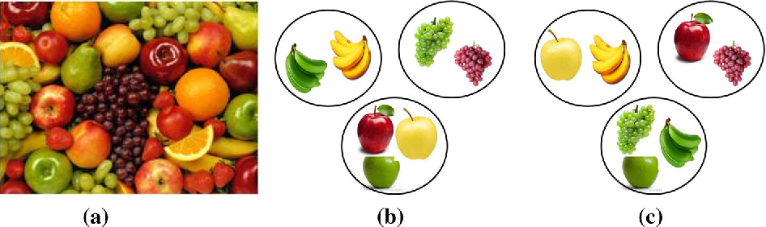
Unsupervised Learning
Clustering is the main type of Unsupervised Learning.
Clustering groups similar objects together.
Input Data Cluster by type Cluster by color

Slide 27
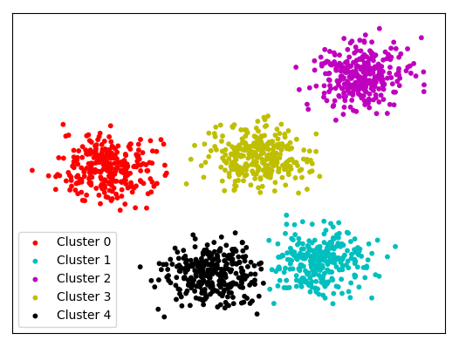
Sample Clustering

Slide 28
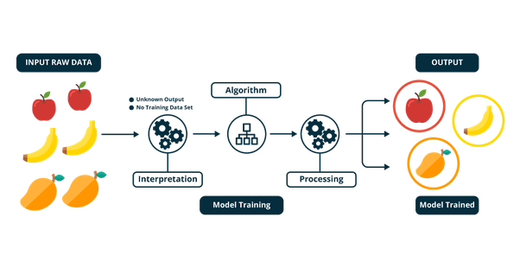
Unsupervised Learning

Slide 29
Unsupervised Learning Example: Categorize Cats and Dogs

Slide 30
Reinforcement Learning
It is about taking suitable action to maximize reward in a particular situation.
It is employed by various software and machines to find the best possible behavior or path it should take in a specific situation.
Close to human learning.

Slide 31

Cont’d
Algorithm learns a policy of how to act in a given environment.
Every action has some impact in the environment, and the environment provides rewards that guides the learning algorithm.

Slide 32
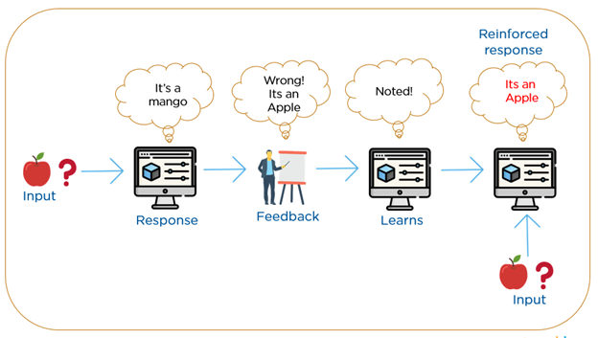
Reinforcement Learning

Slide 33
Different Varieties of Machine Learning
Concept Learning
Clustering Algorithms
Connectionist Algorithms
Genetic Algorithms
Explanation-based and Transformation-based Learning
Reinforcement and Case-based Learning
Macro Learning
Evaluation Functions
Cognitive Learning Architectures
Constructive Induction
Discovery Systems

Slide 34
Languages or Tools for Machine Learning
Python – Open source programming language adopted for machine learning.
R – Open source software. Used for statistical computing and data analysis
Matlab - Developed by MathWorks. Licensed version. Used for variety of applications.
SAS – Statistical Analysis System, was developed and licensed by SAS Institute provides strong support for ML.
Others-
SPSS(Statistical Package for the Social Sciences) – IBM
Julia – MIT(Massachusetts Institute of Technology)

Slide 35
History of Machine Learning (cont.)
2000s
Support vector machines
Kernel & Graphical models
Statistical relational and Transfer learning
Sequence labeling
Collective classification and structured outputs
Computer Systems Applications
Compilers
Debugging
Graphics
Security (intrusion, virus, and worm detection)
E-mail management
Personalized assistants that learn
Learning in robotics and vision

Slide 36
MODEL SELECTION and GENERALIZATION

Slide 37
How do Machines Learn?
Data Input
Abstraction
Generalization
Data Input: Past data or information is utilized as a basis for future decision-making
Abstraction: The input data is represented in a broader way through the underlying algorithm.
Generalization: The abstracted representation is generalized to form a framework for making decisions.

Slide 38
Abstraction
The data, given as input, cannot be used in the original shape and form.
Abstraction helps in deriving a conceptual map based on the input data.
The model may be in any one of forms:
Computational blocks like if/else rules
Mathematical equations
Specific data structures like trees or graphs
Logical groupings of similar observations

Slide 39
Abstraction Cont’d
The choice of the model is human specific.
Selection of model is based on:
The type of problem to be solved.
Nature of the input data.
Domain of the problem.

Slide 40
Generalization
Generalization is used for taking the decisions after training the model.
The model is trained for a limited set of data. If we want to apply the model to take decision on a set of unknown data, we may encounter following problems:
The trained model is aligned with training data too much, hence may not represent the actual trend.
The test data possess certain characteristics apparently unknown to the training data.

Slide 41
Well-posed learning problem
A framework can be designed for deciding whether a problem can be solved using ML. The framework should answer:
What is the problem?
Why does the problem need to be solved?
How to solve the problem?

Slide 42
Designing a Learning System
Choose the training experience
Choose exactly what is too be learned, i.e. the target function.
Choose how to represent the target function.
Choose a learning algorithm to infer the target function from the experience.
Learner
Environment/
Experience
Knowledge
Performance
Element

Slide 43
The Machine Learning Workflow

Slide 44
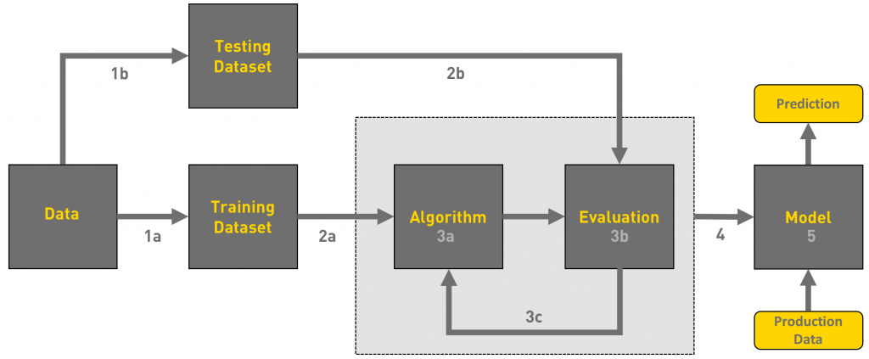
ML WorkFlow

Slide 45
ML WorkFlow
We can define the machine learning workflow in 3 stages.
Gathering data
Data pre-processing
Researching the model that will be best for the type of data
Training and testing the model
Evaluation

Slide 46
Gathering Data
The process of gathering data depends on the type of project we desire to make, if we want to make an ML project that uses real-time data, then we can build an IoT system that using different sensors data. The data set can be collected from various sources such as a file, database, sensor and many other such sources but the collected data cannot be used directly for performing the analysis process as there might be a lot of missing data, extremely large values, unorganized text data or noisy data. Therefore, to solve this problem Data Preparation is done.
We can also use some free data sets which are present on the internet. Kaggle and UCI Machine learning Repository are the repositories that are used the most for making Machine learning models. Kaggle is one of the most visited websites that is used for practicing machine learning algorithms, they also host competitions in which people can participate and get to test their knowledge of machine learning.

Slide 47
Data pre-processing
Data pre-processing is one of the most important steps in machine learning. It is the most important step that helps in building machine learning models more accurately. In machine learning, there is an 80/20 rule. Every data scientist should spend 80% time for data pre-processing and 20% time to actually perform the analysis.
What is data pre-processing?
Data pre-processing is a process of cleaning the raw data i.e. the data is collected in the real world and is converted to a clean data set. In other words, whenever the data is gathered from different sources it is collected in a raw format and this data isn’t feasible for the analysis. Therefore, certain steps are executed to convert the data into a small clean data set, this part of the process is called as data pre-processing.
Why do we need it?
As we know that data pre-processing is a process of cleaning the raw data into clean data, so that can be used to train the model. So, we definitely need data pre-processing to achieve good results from the applied model in machine learning and deep learning projects.

Slide 48
Data pre-processing
Most of the real-world data is messy, some of these types of data are:
1. Missing data: Missing data can be found when it is not continuously created or due to technical issues in the application (IOT system).
2. Noisy data: This type of data is also called outliners, this can occur due to human errors (human manually gathering the data) or some technical problem of the device at the time of collection of data.
3. Inconsistent data: This type of data might be collected due to human errors (mistakes with the name or values) or duplication of data.
Three Types of Data
1. Numeric e.g. income, age
2. Categorical e.g. gender, nationality
3. Ordinal e.g. low/medium/high

Slide 49
Data pre-processing
How can data pre-processing be performed?
These are some of the basic pre — processing techniques that can be used to convert raw data.
1. Conversion of data: As we know that Machine Learning models can only handle numeric features, hence categorical and ordinal data must be somehow converted into numeric features.
2. Ignoring the missing values: Whenever we encounter missing data in the data set then we can remove the row or column of data depending on our need. This method is known to be efficient but it shouldn’t be performed if there are a lot of missing values in the dataset.
3. Filling the missing values: Whenever we encounter missing data in the data set then we can fill the missing data manually, most commonly the mean, median or highest frequency value is used.
4. Machine learning: If we have some missing data then we can predict what data shall be present at the empty position by using the existing data.
5. Outliers detection: There are some error data that might be present in our data set that deviates drastically from other observations in a data set. [Example: human weight = 800 Kg; due to mistyping of extra 0]

Slide 50
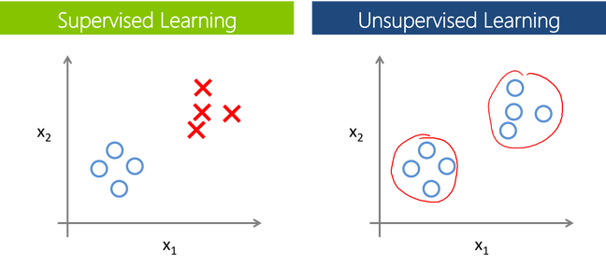
Researching the model that will be best for the type of data
Our main goal is to train the best performing model possible, using the pre-processed data.

Slide 51
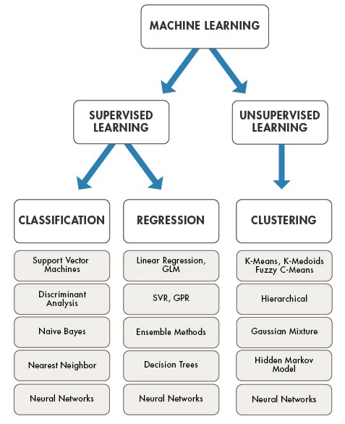
Researching the model that will be best for the type of data
APPLICATIONS

Slide 52
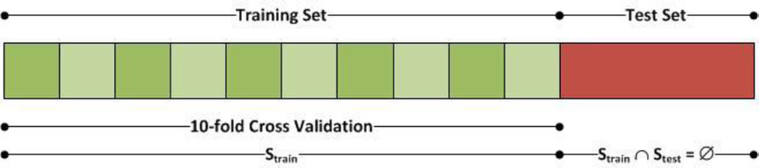
Training and testing the model
For training a model we initially split the model into 3 three sections which are ‘Training data’ ,‘Validation data’ and ‘Testing data’.
You train the classifier using ‘training data set’, tune the parameters using ‘validation set’ and then test the performance of your classifier on unseen ‘test data set’. An important point to note is that during training the classifier only the training and/or validation set is available. The test data set must not be used during training the classifier. The test set will only be available during testing the classifier

Slide 53
Training and testing the model
Training set: The training set is the material through which the computer learns how to process information. Machine learning uses algorithms to perform the training part. A set of data used for learning, that is to fit the parameters of the classifier.
Validation set: Cross-validation is primarily used in applied machine learning to estimate the skill of a machine learning model on unseen data. A set of unseen data is used from the training data to tune the parameters of a classifier.
Test set: A set of unseen data used only to assess the performance of a fully-specified classifier
Once the data is divided into the 3 given segments we can start the training process.
In a data set, a training set is implemented to build up a model, while a test (or validation) set is to validate the model built. Data points in the training set are excluded from the test (validation) set. Usually, a data set is divided into a training set, a validation set (some people use ‘test set’ instead) in each iteration, or divided into a training set, a validation set and a test set in each iteration.

Slide 54
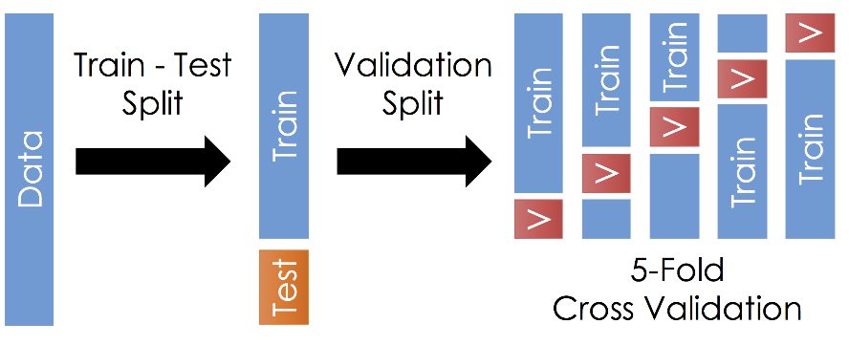
Training and testing the model

Slide 55
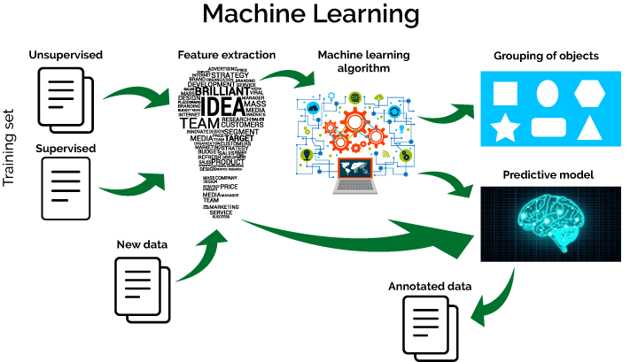
EVALUATION
Model Evaluation is an integral part of the model development process. It helps to find the best model that represents our data and how well the chosen model will work in the future. To improve the model we might tune the hyper-parameters of the model and try to improve the accuracy and also looking at the confusion matrix to try to increase the number of true positives and true negatives.

Slide 56
Sample Applications
Web search
Computational biology
Finance
E-commerce
Space exploration
Robotics
Information extraction
Social networks
Debugging software
[Your favorite area]

Slide 57
Supervised Learning Classification
Example: Cancer diagnosis
Training Set
Use this training set to learn how to classify patients where diagnosis is not known:
Test Set
Input Data
Classification
The input data is often easily obtained, whereas the classification is not.

Slide 58
Classification Problem
Goal: Use training set + some learning method to produce a predictive model.
Use this predictive model to classify new data.
Sample applications:

Slide 59
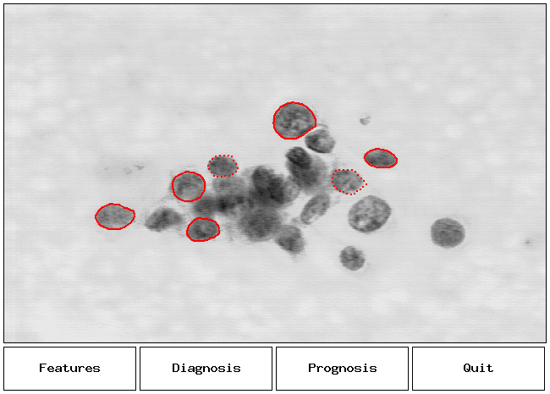
Application: Cancer Diagnosis

Slide 60
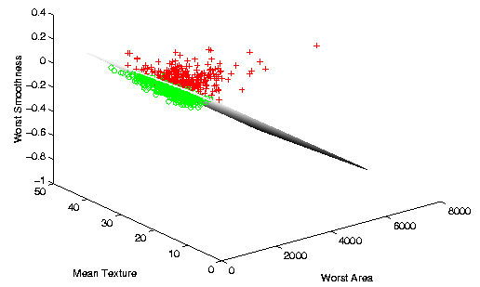
Cancer Diagnosis Separation

Slide 61

Robotics and ML
Areas that robots are used:
Industrial robots
Military, government and space robots
Service robots for home, healthcare, laboratory
Why are robots used?
Dangerous tasks or in hazardous environments
Repetitive tasks
High precision tasks or those requiring high quality
Labor savings
Control technologies:
Autonomous (self-controlled), tele-operated (remote control)

Slide 62
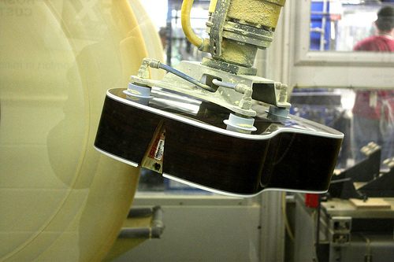
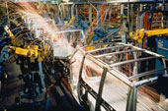
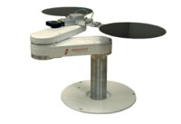
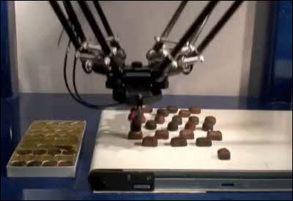
Industrial Robots
Uses for robots in manufacturing:
Welding
Painting
Cutting
Dispensing
Assembly
Polishing/Finishing
Material Handling
Packaging, Palletizing
Machine loading

Slide 63
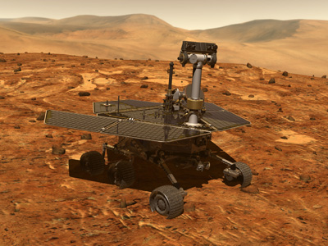
Space Robots
Mars Rovers – Spirit and Opportunity
Autonomous navigation features with human remote control and oversight

Slide 64
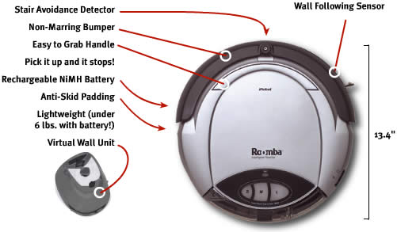
Service Robots
Many uses…
Cleaning & Housekeeping
Humanitarian Demining
Rehabilitation
Inspection
Agriculture & Harvesting
Lawn Mowers
Surveillance
Mining Applications
Construction
Automatic Refilling
Fire Fighters
Search & Rescue
iRobot Roomba vacuum cleaner robot

Slide 65
Issues in Machine Learning
What algorithms can approximate functions well and when?
How does the number of training examples influence accuracy
Problem representation / feature extraction
Intention/independent learning
Integrating learning with systems
What are the theoretical limits of learnability
Transfer learning
Continuous learning

Slide 66
Scaling issues in ML
Number of
Inputs
Outputs
Batch vs realtime
Training vs testing

Slide 67
Machine Learning VS Human Learning
Some ML behavior can challenge the performance of human experts (e.g., playing chess)
Although ML sometimes matches human learning capabilities, it is not able to learn as well as humans or in the same way that humans do
There is no claim that machine learning can be applied in a truly creative way
Formal theories of ML systems exist but are often lacking (why a method succeeds or fails is not clear)
ML success is often attributed to manipulation of symbols (rather than mere numeric information)

Slide 68
END OF MODULE-1

